Slide 1

FILE RAKSHAK
PRESENTED BY-
SHASHANK SHUKLA

Slide 2
AGENDA
INTRODUCTION
FEATURES
CRYPTOGRAPHY,STEGANOGRAPHY
TOOLS USED
SUPPORTED OPERATING SYSTEMS
MODULES
SNAP SHOT OF PROJECT
CONCLUSION
REFERENCES

Slide 3
INTRODUCTION
File Rakshak s/w is a fast, simple s/w to store and protect critical and sensitive files on any drive.
File Rakshak s/w creates a private vault and simply drag-and-drop your valuable files inside.
It enables you to encrypt and password protect any type of file, including documents, images, videos etc.
Once protected, the file can only be opened with the proper password.

Slide 4
FEATURES OF FILE RAKSHAK
It can protect any type of file.
Integration with the context-menu of Windows.
Graphical user interface style Windows simple and functional.
Protection files through the most advanced algorithm RSA.

Slide 5
High safety of the protected files.
Lock files and folders with passwords .
Use the concept of Steganography
File rakshak will save you hours of learning time.
File rakshak runs on a wide range of Windows platforms.
Once a file is locked using File rakshak it can not be moved to another system or drive .

Slide 6
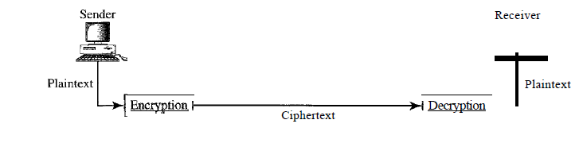
Cryptography
Cryptography, a word with Greek origins, means "secret writing."
The art of protecting information by transforming it (encrypting it) into an unreadable format, called cipher text. Only those who possess a secret key can decipher (or decrypt) the message into plain text. Encrypted messages can sometimes be broken by cryptanalysis, also called codebreaking, although modern cryptography techniques are virtually unbreakable.

Slide 7
Steganography
Greek for “covered writing”
“The art and science of writing hidden messages in such a way that no one apart from the intended recipient even knows that a message has been sent.”
There are following methods to implement steganography-
Least significant bit (LSB) method.
JSTEG algorithm.
F5.

Slide 8
Tools Used
Visual Studio 2012 is used for development of this application.
Microsoft .NET framework 4.5 as Application architecture.
Photoshop CS5 for graphics and picture editing and designing.
C# language used.

Slide 9
WHAT IS .NET
A Microsoft strategy and new technology for delivering software services to the desktop and to the web.
Components include:
MS Intermediate Language.
The CLR- common language runtime.
A rich set of libraries (Framework Class Libraries) available to all .NET languages.
The .NET languages such as C#, VB.NET etc that conform to CLR.
IIS to manage simple pages of code so that they can be complied into full .NET programs. These generate HTML for the browser.

Slide 10
C#
C# (pronounced "C-sharp") is an object-oriented programming language from Microsoft that aims to combine the computing power of C++ with the programming ease of Visual Basic.
C# is designed to work with Microsoft's . Net platform.
It provide support for software engineering principles such as strong type checking, array bounds checking, detection of attempts to use uninitialized variables, and automatic garbage collection

Slide 11
Visual Studio 2012
Microsoft Visual Studio is an integrated development environment (IDE) from Microsoft.
It is used to develop console and graphical user interface applications along with Windows Forms applications, web sites, web applications, and web services.
Visual Studio includes a code editor supporting IntelliSense as well as code refactoring.
Visual Studio supports different programming languages by means of language services.

Slide 12
Supported Operating Systems
Windows® XP
Windows Vista®
Windows® 7
Windows® 8

Slide 13
Design
. The design is a solution, how to approach to the creation of a new system. This is composed of several steps. It provides the understanding and procedural details necessary for implementing the system recommended in the feasibility study. Designing goes through logical and physical stages of development, logical design reviews the present physical system, prepare input and output specification, details of implementation plan and prepare a logical design walkthrough
Data Flow Diagram (DFD):
DFD are commonly used during problem analysis.
DFD shows the flow of data through a system.
DFD aims to capture the transformation that take place within the system to the input data so that eventually the output data is produced.
There are several level of DFD are used to describe the flow of information.

Slide 14
0 Level DFD for File Rakshak:
user
File rakshak
Authenticate

Slide 15
1 Level DFD for File Rakshak:
Encryption/decryption
Encrypted data
user
Stegnography
Hidden information in image
File lock
Lock files

Slide 16
Modules
Authentication
File Lock
Encryption & Decryption
Steganography

Slide 17
1. Authentication: Authenticate user has the full authority over the Application. You can protect virtually any "real" folder with a password, allowing only the authorized users to open the protected folder. You can protect an unlimited number of folders, each with its own password
2. Encryption & Decryption: Encryption in software provides advanced data encryption and file encryption for desktops, laptops, and removable storage devices. It offers scalable, enterprise-wide security that prevents unauthorized access by using strong access control and powerful encryption. Symantec Endpoint Encryption provides a central management console, enabling safe, central deployment and management of encryption to endpoints
3. File lock: With the help of File lock we can lock or unlock any file.

Slide 18
4. Steganography: Steganography is a means of obscuring data where secret messages are hidden inside computer files such as images, sound files, videos and even executable files so that, no one except the sender and the receiver will suspect the existence of stealth information in it. Steganography may also involve the usage of cryptography where the message is first encrypted before it is concealed in another file. Generally, the messages appear to be something else such as an image, sound or video so that the transfer of secret data remains unsuspected.

Slide 19
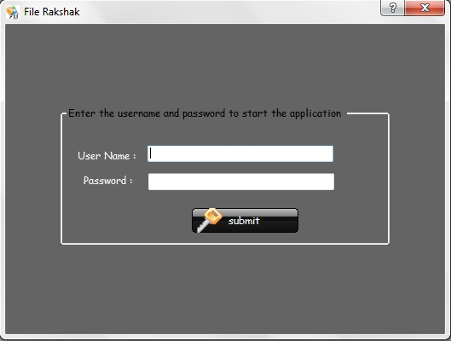
Snap shot of project
Before Form Authentication

Slide 20
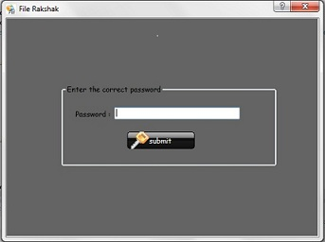
After Form Authentication

Slide 21
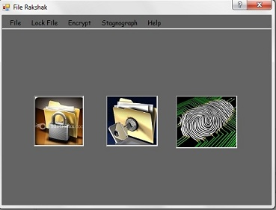
Main Form

Slide 22
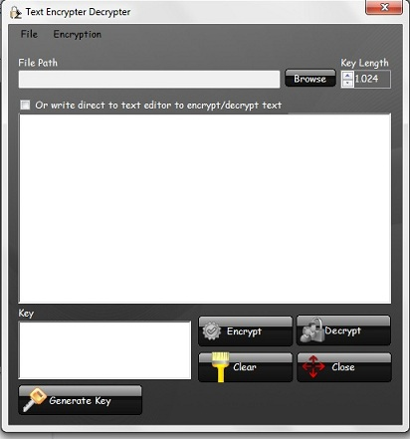
Form Encrypter & Decrypter

Slide 23
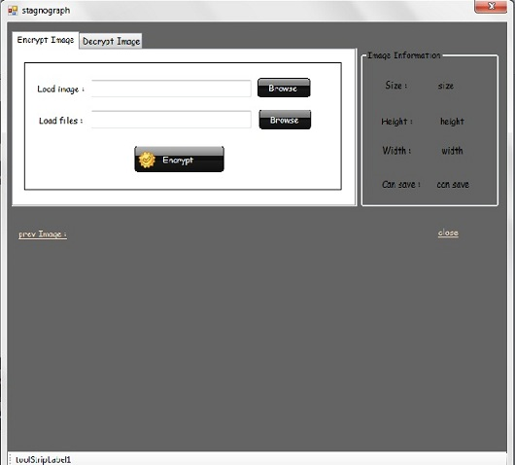
Form for Steganography

Slide 24
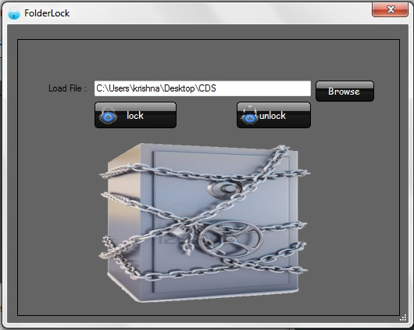
Form for Folder Lock

Slide 25
Conclusion
The entire project has been developed and deployed as per the requirements and necessity to reduce the manual process and to increase the efficiency for protection of files. It is found to be bug free as per the testing standards that are implemented. The system provides an efficient way of encryption & decryption of file, hidden the data in image (Steganography) and lock the files. Efforts have been made to fully automate the existing system and enhance the features. The software is developed and designed to provide flexibility and a friendly interface. The software can also be extended in the future for development.

Slide 26
References
1. The complete Reference Visual C#.NET
2. Beginning C#.NET (Wrox Publication)
3. System Analysis and Design – Alias M. Awad
4. Software Engineering – Roger Pressman
5. Millman,J., ( 2006 ), System Design, Analysis and Implementation, Tata McGraw Hill Publication, New Delhi.
Websites:
1. www.microsoft.com
2. www.w3schools.com
3. www.codeproject.com

